Slide 1
Lab2 - Classification task by Resnet18 on CIFAR10
Advisor：Tsai, Chia-Chi
TA：陳喬雅

Slide 2
Outline
Lab2 task
Layer introduction
ResNet18
CIFAR-10
Sample code introduction

Slide 3
Outline
Lab2 task
Layer introduction
ResNet18
CIFAR-10
Sample code introduction

Slide 4
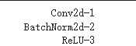
1. Lab2 task-1
Use pytorch to implement an specific classification DNN model, dataset CIFAR10
Hint:要包含兩層的藍色框layer，可在中間加上pooling layer，最後要加一層FC以達成分類任務

Slide 5
1. Lab2 task-1
2) Print model summary(including parameters)
3) Print test accuracy, plot epoch-train accuracy, epoch-val accuracy, epoch-train loss, epoch-val loss.
Accuracy (20%)
Accuracy | Score
>80% | 20
>70% | 16
>60% | 12

Slide 6
1. Lab2 task-2
Use Resnet18 to train on CIFAR-10
2) Experiment on the following and compare the result with baseline
Input image normalization
Data augmentation
Different base learning rate and update strategy
3) Print test acc
4) Plot train-loss, val-loss, train-acc, val-acc
Accuracy (20%)
Report (60%)
Accuracy | Score
>85% | 20
>80% | 16
>70% | 12

Slide 7
1. Lab2 task
Recommend platform: colab with python (Use Pytorch)
Upload platform: NCKU moodle
Upload compressed StudentID_lab2.zip file including:
學號_lab2.ipynb
IPython notenook 須包含程式碼跟結果
學號_lab2.pdf
各項print以及plot輸出
實作所運到的困難及解決方法
Provided file: lab2 sample code
Q&A: course.aislab@gmail.com

Slide 8
Outline
Lab2 task
Layer introduction
ResNet18
CIFAR-10
Sample code introduction

Slide 9
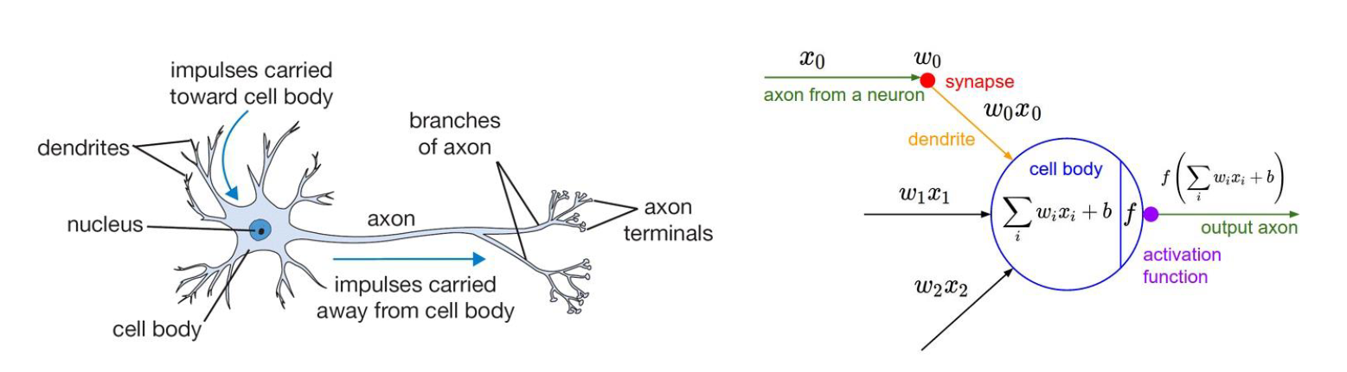
3. Layers introduction
Single neuron.

Slide 10
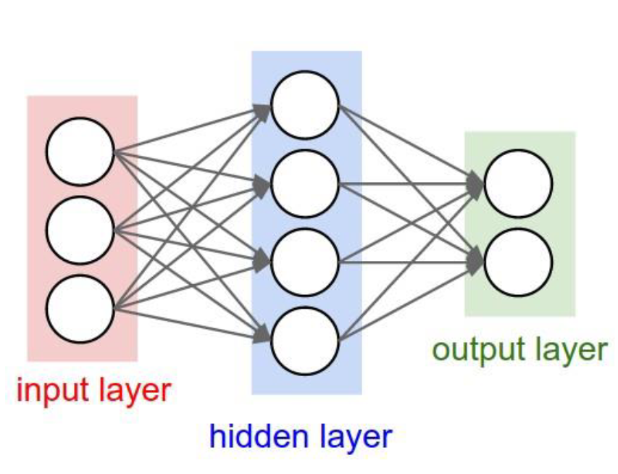
3. Layers introduction
Multiple neurons.

Slide 11

3. Layers introduction
Mimicking multiple neurons by layers.

Slide 12
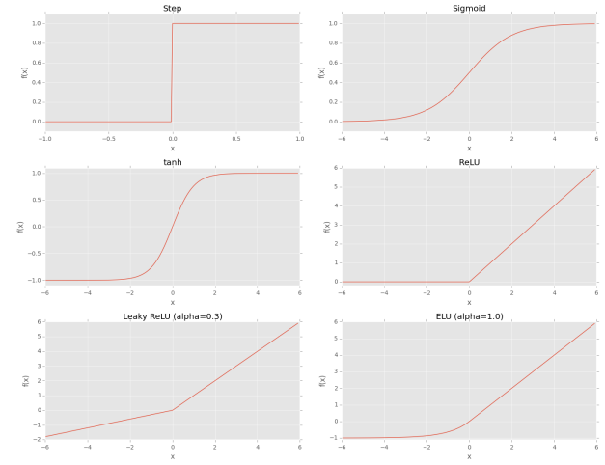
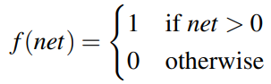
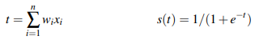
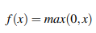
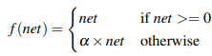
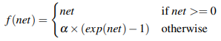
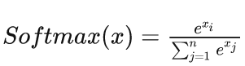
3. Layers introduction – Activation function
Activation Functions
1. step:
2. sigmoid:
3. tanh:
4. Rectified Linear Unit (ReLU)
5. Leaky ReLUs
6. Exponential Linear Units (ELUs)
7. Softmax:
Notes:
Characteristics of a Sigmoid Activation Function
It is used for Binary Classification in the Logistic Regression model
The probabilities sum of sigmoid does not need to be 1
Characteristics of a Softmax Activation Function
It is used for Multi-classification in the Logistics Regression model
The probabilities of softmax sum will be 1

Slide 13

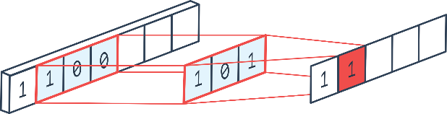
3. Layers introduction – Convolution layer
self.conv1 = nn.Conv2d(3, 32, kernel_size=3, padding=1)
2D Convolution is using a ‘kernel’ to extract certain ‘features’ from an input image.
2D:
1D:
https://towardsdatascience.com/types-of-convolution-kernels-simplified-f040cb307c37

Slide 14
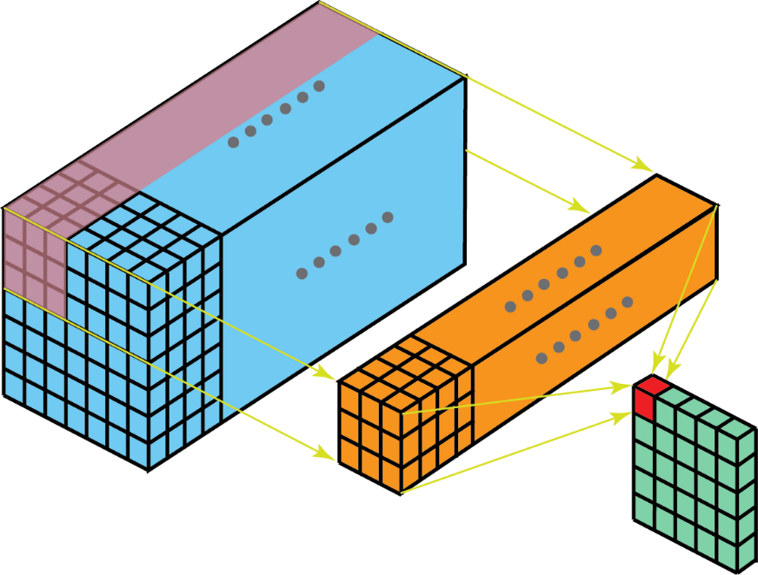
3. Layers introduction – Convolution layer
Kernel vs Filter
A kernel is, as described earlier, a matrix of weights which are multiplied with the input to extract relevant features. The dimensions of the kernel matrix is how the convolution gets it’s name. For example, in 2D convolutions, the kernel matrix is a 2D matrix.
A filter however is a concatenation of multiple kernels, each kernel is assigned to a particular channel of the input. Filters are always one dimension more than the kernels. For example, in 2D convolutions, filters are 3D matrices (which is essentially a concatenation of 2D matrices i.e. the kernels). So for a CNN layer with kernel dimensions h*w and input channels k, the filter dimensions are h*w*k.
https://towardsdatascience.com/types-of-convolution-kernels-simplified-f040cb307c37
Input
(7,7,N)
Filter(3,3,k)
Kernel(3,3)

Slide 15
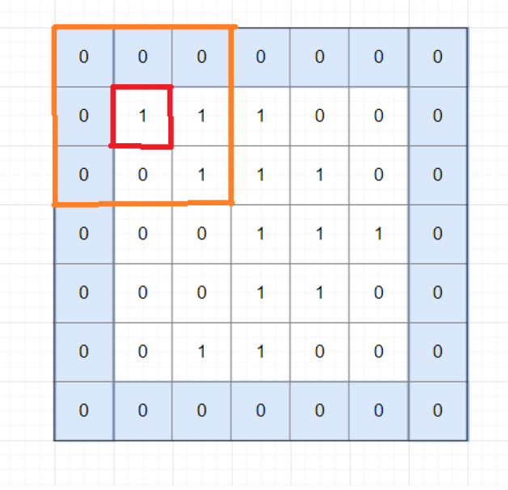
3. Layers introduction – Convolution layer
E.g. Convolution on grayscale image
Convolution/Padding
X: m x n
W: k x k
➔ Y: same size with X
Padding = p = 1
https://medium.com/@ayeshmanthaperera/what-is-padding-in-cnns-71b21fb0dd7

Slide 16
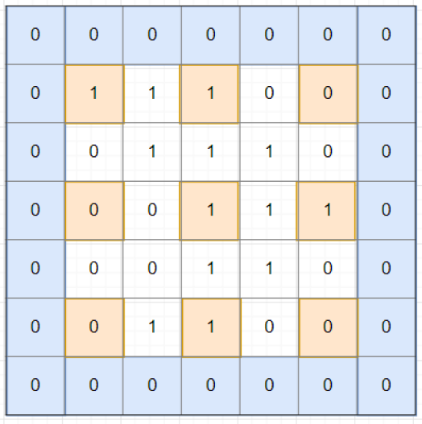
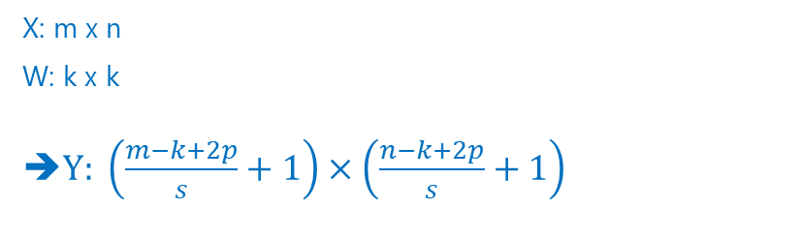
3. Layers introduction – Convolution layer
E.g. Convolution on grayscale image
Convolution/Stride = s, only compute convolution on pixels x_{1+i*s, 1+j*s}
e.g.
X: m x n, m = n = 5
W: k x k, k = 3
$$\left(\frac{5−3+2∗1}{2}+1\right)×\left(\frac{5−3+2∗1}{2}+1\right)=(3,3)$$
Padding = p = 1, Stride = s =2
X: m x n
W: k x k
➔$Y: \left(\frac{m−k+2p}{s}+1\right)×\left(\frac{n−k+2p}{s}+1\right)$

Slide 17
3. Layers introduction – Convolution layer
E.g. Convolution on grayscale image
Convolution/Stride = s, only compute convolution on pixels x_{1+i*s, 1+j*s}
e.g.
X: m x n, m = n = 5
W: k x k, k = 3
$$\left(\frac{5−3+2∗1}{2}+1\right)×\left(\frac{5−3+2∗1}{2}+1\right)=(3,3)$$
Padding = p = 1, Stride = s =2
X: m x n
W: k x k
➔$Y: \left(\frac{m−k+2p}{s}+1\right)×\left(\frac{n−k+2p}{s}+1\right)$

Slide 18
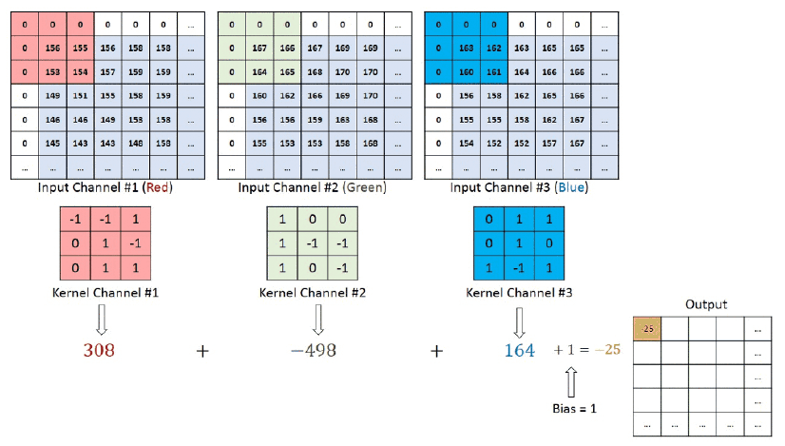

3. Layers introduction – Convolution layer
E.g. Convolution on RGB image
e.g.
Input X: NxN
Kernel W: 3x3
Filters(channels =3) :3 x 3 x 3

Slide 19
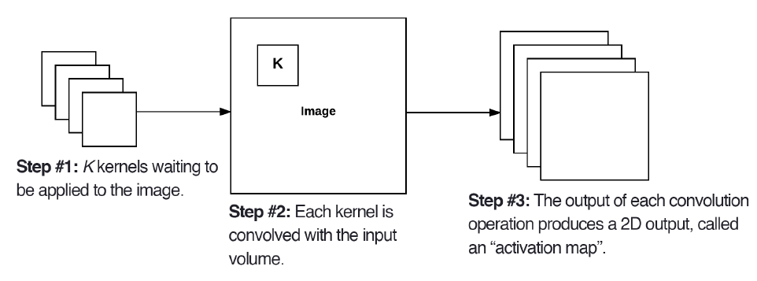
3. Layers introduction – Convolution layer
Left: At each convolutional layer in a CNN, there are K kernels applied to the input volume. Middle: Each of the K kernels is convolved with the input volume.
Right: Each kernel produces an 2D output, called an activation map(feature map).
https://towardsdatascience.com/simple-introduction-to-convolutional-neural-networks-cdf8d3077bac

Slide 20
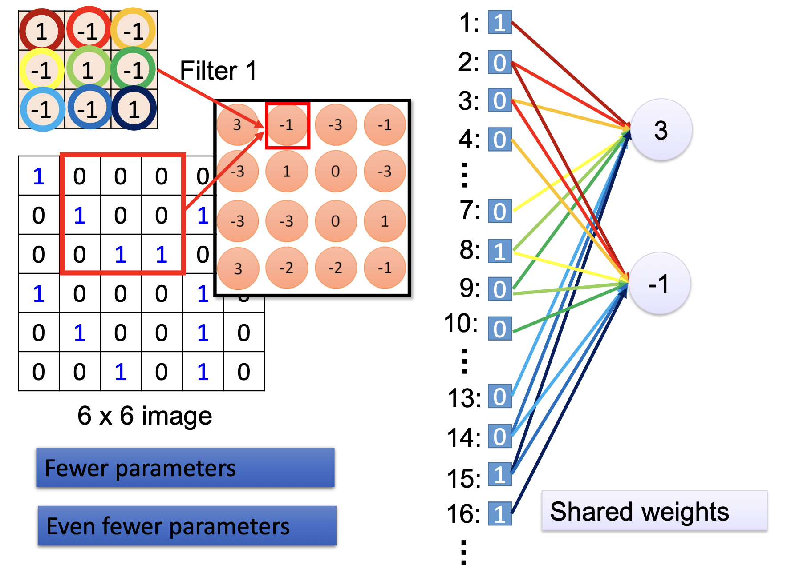

3. Layers introduction – Convolution layer
Why do we use CNN instead of NN?
reduce the number of parameters(shared weights)
accelerate execution time
combine image features
No longer need experts to design convolutional kernels
Notes:
Local connectivity: each neuron only receives input from a small local group of the pixels in the input image. This is what is meant by "local connectivity", all of the inputs that go into a given neuron are actually close to each other.
Shared weights: The weight values within filters are learnable during the training phase of a CNN. The output dimension of the convolutional layer has a depth component, if we partition each segment of the output we will obtain a 2D plane of a feature map. The filter used on a single 2D plane contains a weight that is shared across all filters used across the same plane.

Slide 21
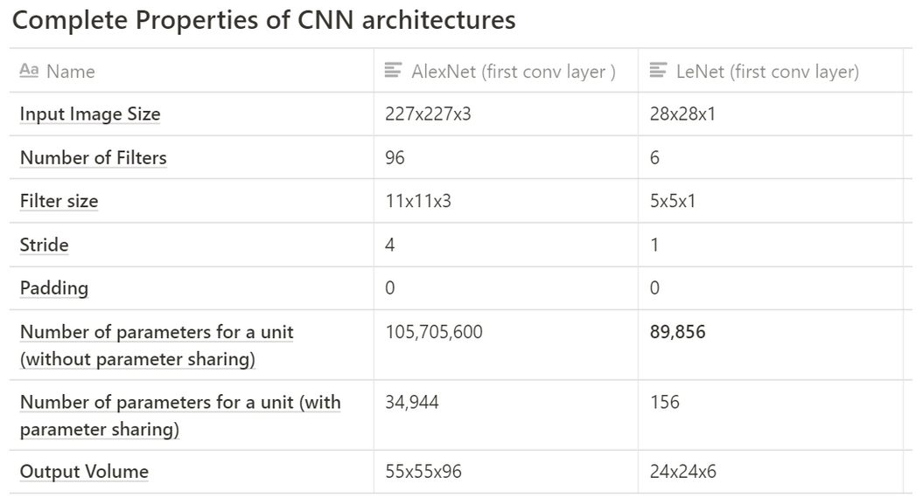
3. Layers introduction – Convolution layer
Calculation of parameters, take LeNet for example:
1. Output width of conv layer:
= ((28–5+2*0) / 1) +1
= 24 (conv layer output width)
2. Number of neurons/units within the conv layer
= output height * output width * number of feature maps(channels)
= 24x24x6 (conv output volume)
= 3,456 units
3. Number of training parameters or weights within the conv layer (without weight sharing)
= 3456* ((5 * 5 * 1) + 1 bias)
= ‭89,856‬ weights
4. Number of training parameters or weights with weight sharing (with weight sharing)
= 6*((5*5*1) + 1 bias)
= 156 weights
channels
kernel
https://towardsdatascience.com/understanding-parameter-sharing-or-weights-replication-within-convolutional-neural-networks-cc26db7b645a

Slide 22
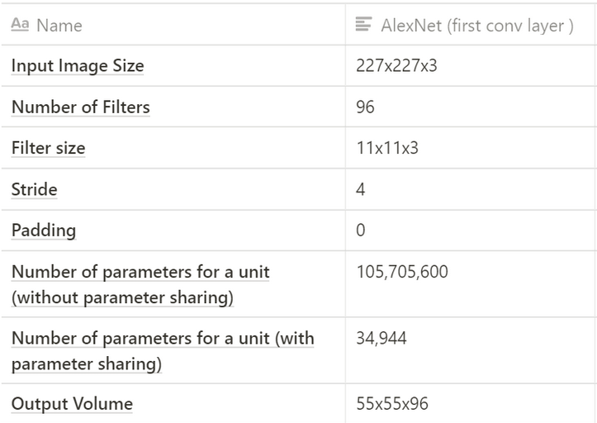
3. Layers introduction – Convolution layer
Calculation of parameters, take AlexNet for example:
1. Output width of conv layer:
= ((227–11) / 4) +1
= 55 (conv layer output width)
2. Number of neurons/units within the conv layer
= output height * output width * number of feature maps
= 55x55x96 (conv output volume)
= 290,400 units
3. Number of training parameters or weights within the conv layer (without weight sharing)
= 290400 * ((11 * 11 * 3) + 1 bias)
= ‭105,415,600‬ weights
4. Number of training parameters or weights with weight sharing (with weight sharing)
= 96*((11*11*3) + 1 bias)
= 34,944 weights
channels
kernel

Slide 23
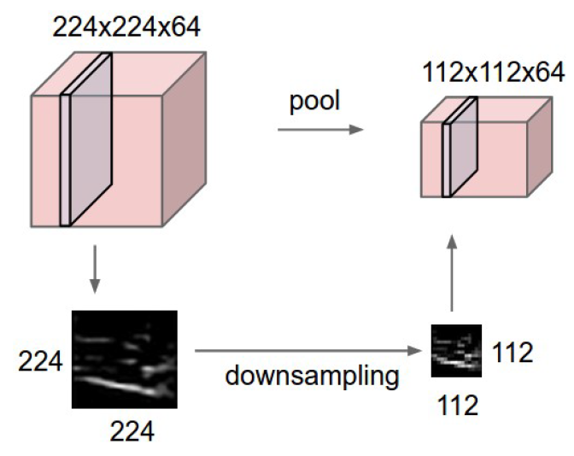
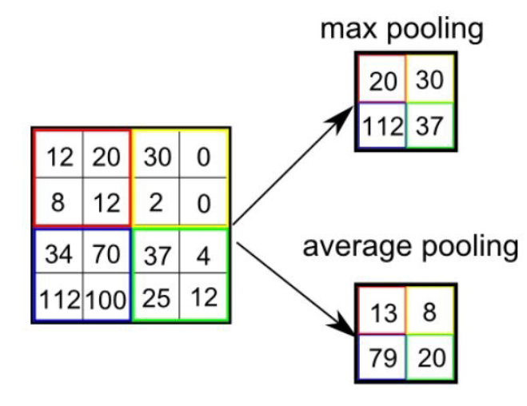
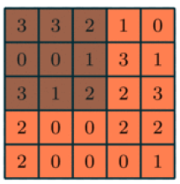
3. Layers introduction – Pooling layer
To reduce model dimensionality by sliding window approach.
-Max pooling: Discard unnecessary or noisy features.
-Average pooling
Pooling layer size (2,2), stride = 2
max pooling layer with size=(3,3), stride=1, padding=0
after pooling layer with size=(2,2), stride=2, padding=0

Slide 24
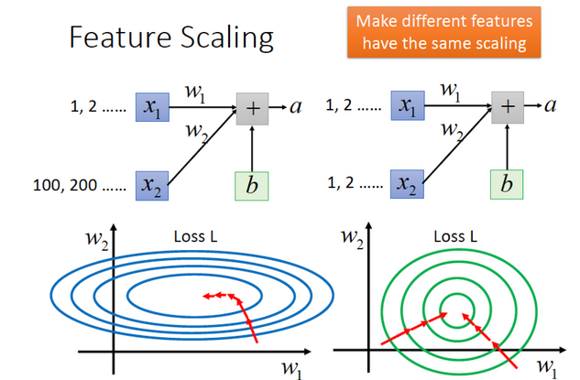
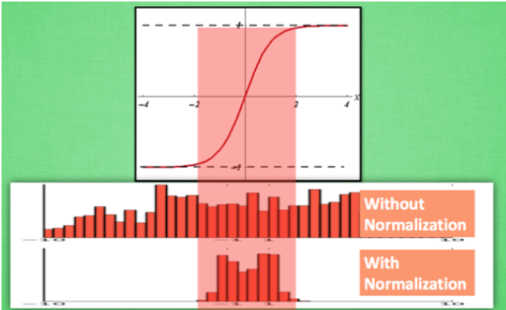
3. Layers introduction – Batch normalization layer
Efficiently normalize based on loaded batch data.
Train faster with bigger learning rate by avoiding covariant problem.
Avoiding vanishing gradients especially effective for sigmoid, tanh.
NTU Professor Lee’ s ML: https://www.youtube.com/watch?v=BZh1ltr5Rkg

Slide 25
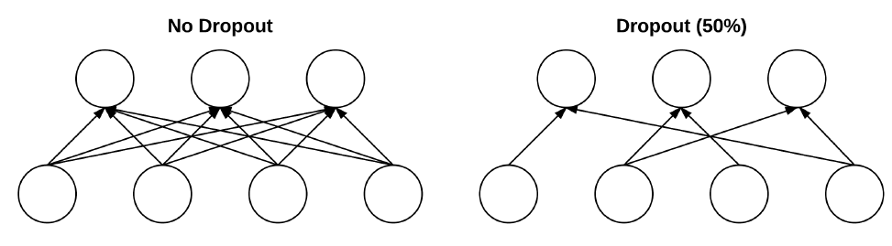
3. Layers introduction – Dropout layer
To generalize the model by randomly dropping multiple redundant nodes.
Usually placed between fully-connected layers.
Left: Two layers of a neural network that are fully-connected with no dropout. Right: The same two layers after dropping 50% of the connections.
Connections: 12
p = 0.5
Connections: 6

Slide 26
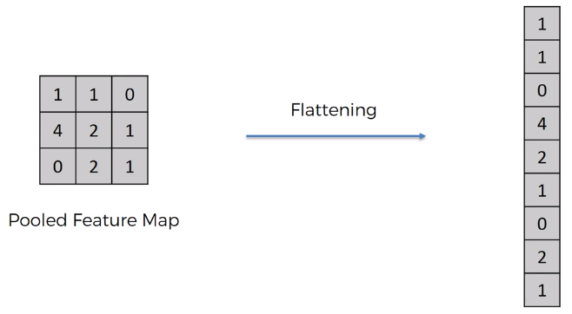
3. Layers introduction – Flatten layer
Flatten layer is used to make the multidimensional input one-dimensional, commonly used in the transition from the convolution layer to the full connected layer.

Slide 27
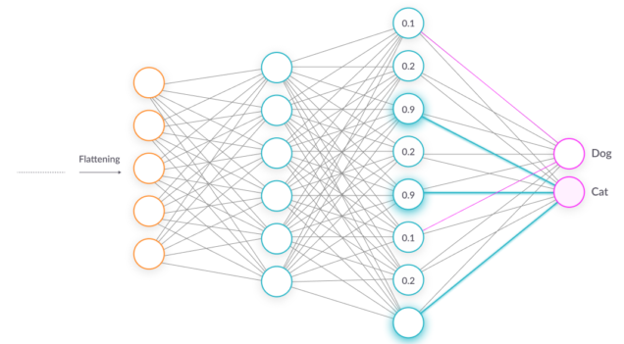
3. Layers introduction – FC layer
Fully connected layer.
Each neuron in the dense layer receives input from all neurons of its previous layer, where neurons of the dense layer perform matrix-vector multiplication
https://www.tensorflow.org/api_docs/python/tf/keras/layers/Dense
self.fc1 = nn.Linear(4096, 10)

Slide 28
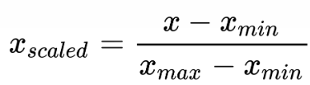
Image normalization
min/max normalization: 縮到0~1或-1~1之間，通常是input range已知的情況可用，
output = input / 255
transforms.ToTensor(): range(0, 255) -> range(0.0, 1.0)

Slide 29
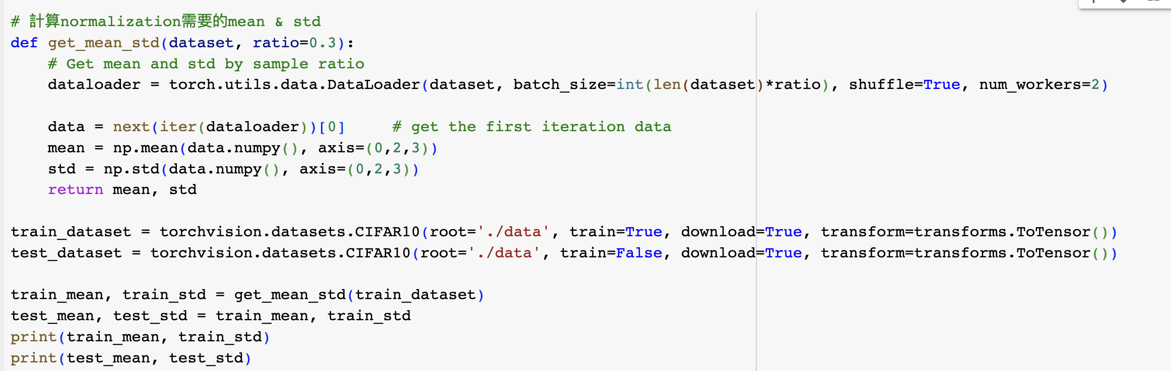
Image normalization
Standardization: 將sampled dataset的mean和std轉換成接近於0和1，以此減少偏差，避免被某部分資料支配，通常是用在Input range未知的情況，以採樣的方式來取得。
mean -> 0 ：unbiased的data更有利於model學習
std -> 1 ：減緩梯度消失和梯度爆炸

Slide 30
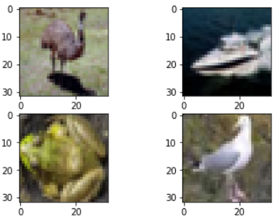
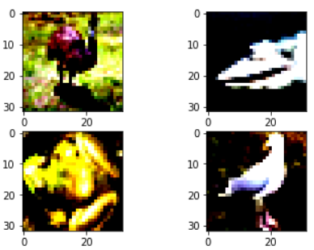
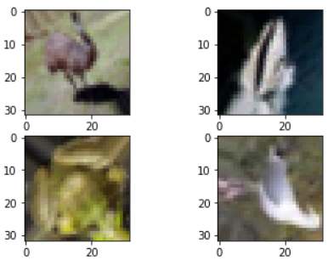
Data augmentation
將圖片進行旋轉、調整大小、比例尺寸，或改變亮度色溫、翻轉、加入Gaussian noise等處理
transforms.RandomHorizontalFlip()
Transforming and augmenting images — Torchvision main documentation
original
standardization
rotation

Slide 31
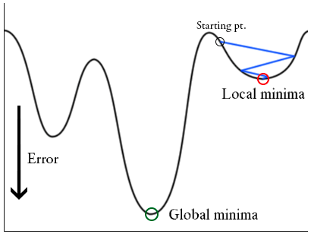
Learning rate and update strategy
訓練model時，若採用固定的learning rate，容易找到local minima而非global minima
Training error
Trainging parameter(w)

Slide 32
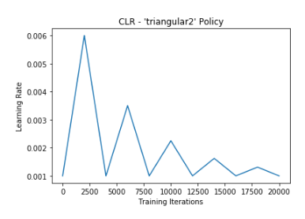
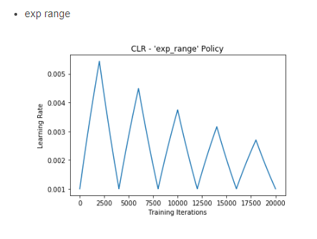
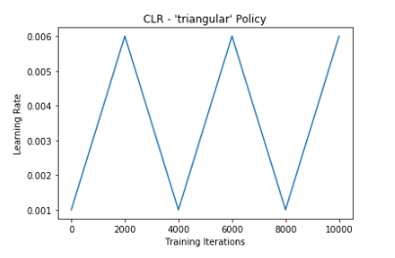
Learning rate and update strategy
Learning Rate Decay : 通常在訓練一定epoch後，會對學習率進行衰減，從而讓model收斂得更好
Cyclical Learning Rates: 設定學習率的上下限後，讓學習率在一定範圍內衰降或增加，在遇到saddle point不會卡住
Notes:
saddle point: 模型訓練後期，其一階梯度已經趨近0，但從不同維度觀察黑點的位置，從A~B的維度是最小值，但從C~D的維度卻是最大值

Slide 33
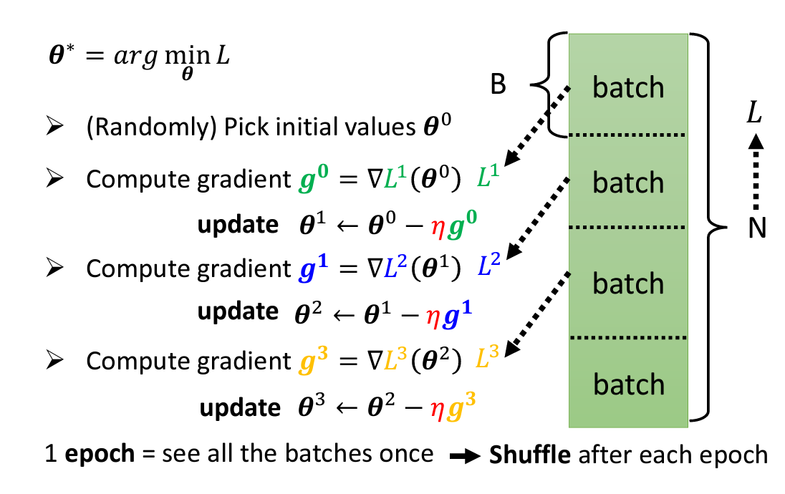
Batch size

Slide 34
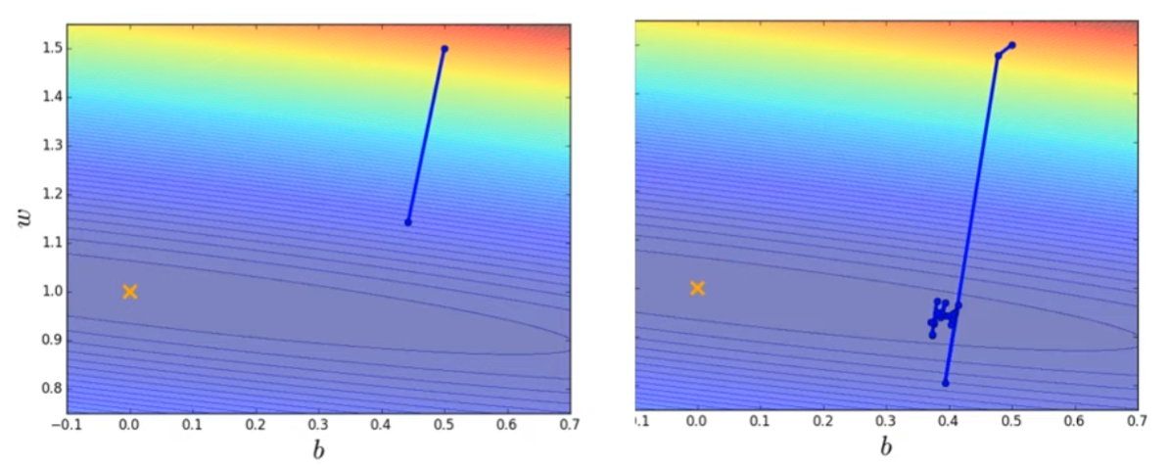
Large batch v.s. small batch
Consider 20 example(N=20)
Batch size = N(Full batch) Batch size = 1
Update after seeing Update for each example
all 20 examples Update 20 times in an epoch
Stable
Noisy

Slide 35
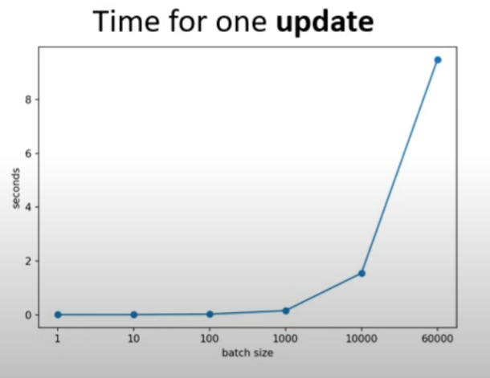
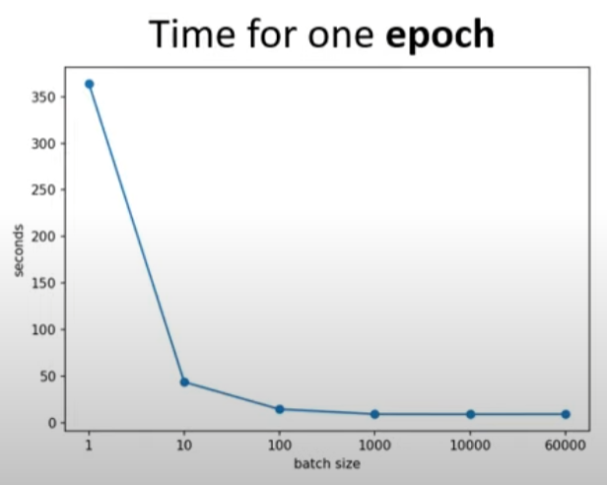
Large batch v.s. small batch
Larger batch size doesn’t require longer time to compute gradient(update)
Smaller batch requires longer time for one epoch(考慮平行計算)
60updates
60000 updates in an epoch

Slide 36
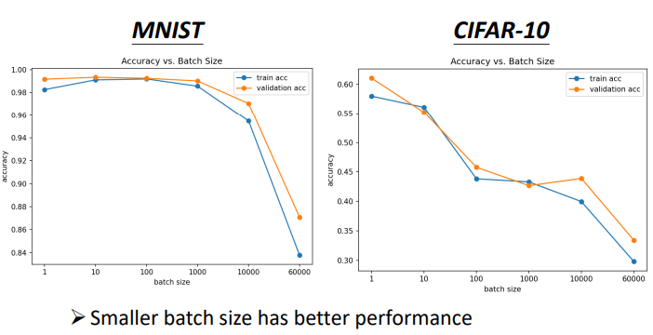
Large batch v.s. small batch

Slide 37
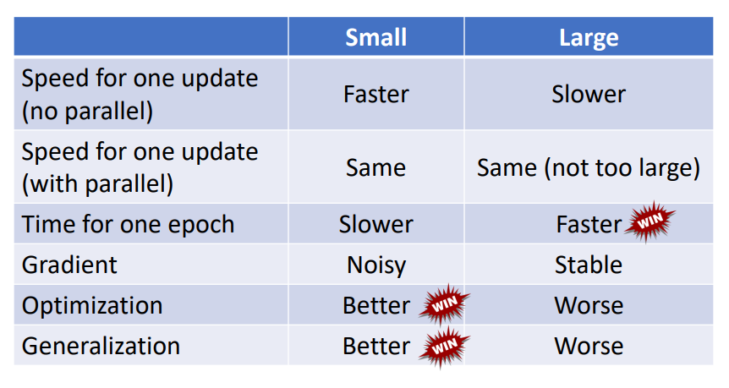
Batch size
Batch size is a hyperparameter you have to decide
參考: https://speech.ee.ntu.edu.tw/~hylee/ml/ml2021-course-data/small-gradient-v7.pdf

Slide 38
Outline
Lab2 task
Layer introduction
ResNet18
CIFAR-10
Sample code introduction

Slide 39
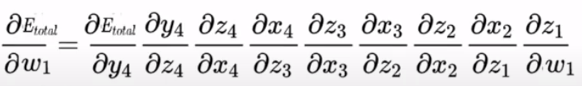
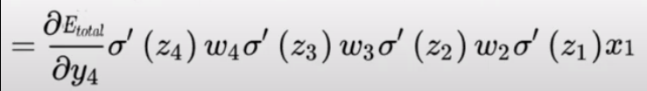
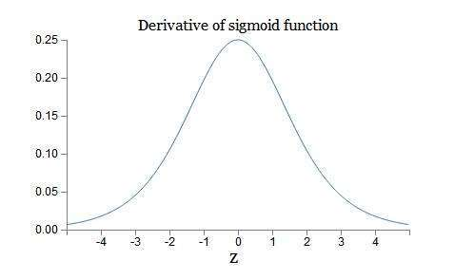
Vanishing gradient problem
X
w1
y1
w2
y2
w3
y3
w4
y4
Error
因為我們初始化的權重通常是在0附近的小數，
w2*w3*w4會很小，導致w1的梯度消失
若我們activation function是使用sigmoid，
因為simoid導數的閾值是(0,0.25)，導致神經網絡在反向傳播的時候，
其梯度越來越小，最後甚至根本無法訓練
使用Batch Normalization或改用ReLU可以解決

Slide 40
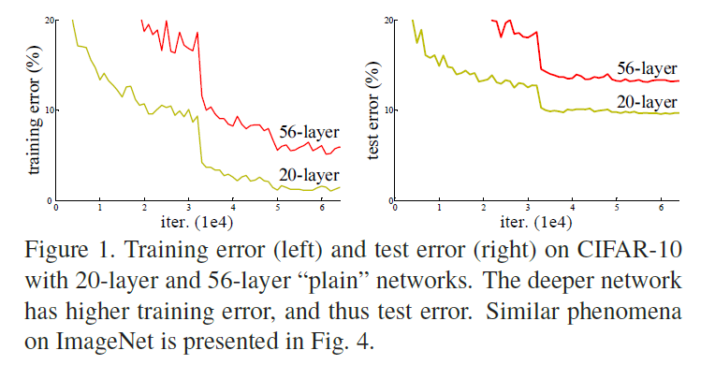
Degradation
但當深度逐漸增加，我們發現56層的神經網路反而比20層網路結果還差。這樣的結果並非來自於 overfitting和Vanishing gradient problem，而是因為深度增加連帶著使得 training error 增加所導致的退化問題，以至於深層的特徵丟失了淺層特徵的原始模樣

Slide 41
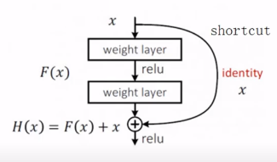
ResNet-18
用Deep residual Network來處理degradation，這樣做能在網路層加深後，正確率至
少不會變的更差。
輸入是x
原本學習是: x → F(x)
改成學習: H(x) =F(x) + x

Slide 42
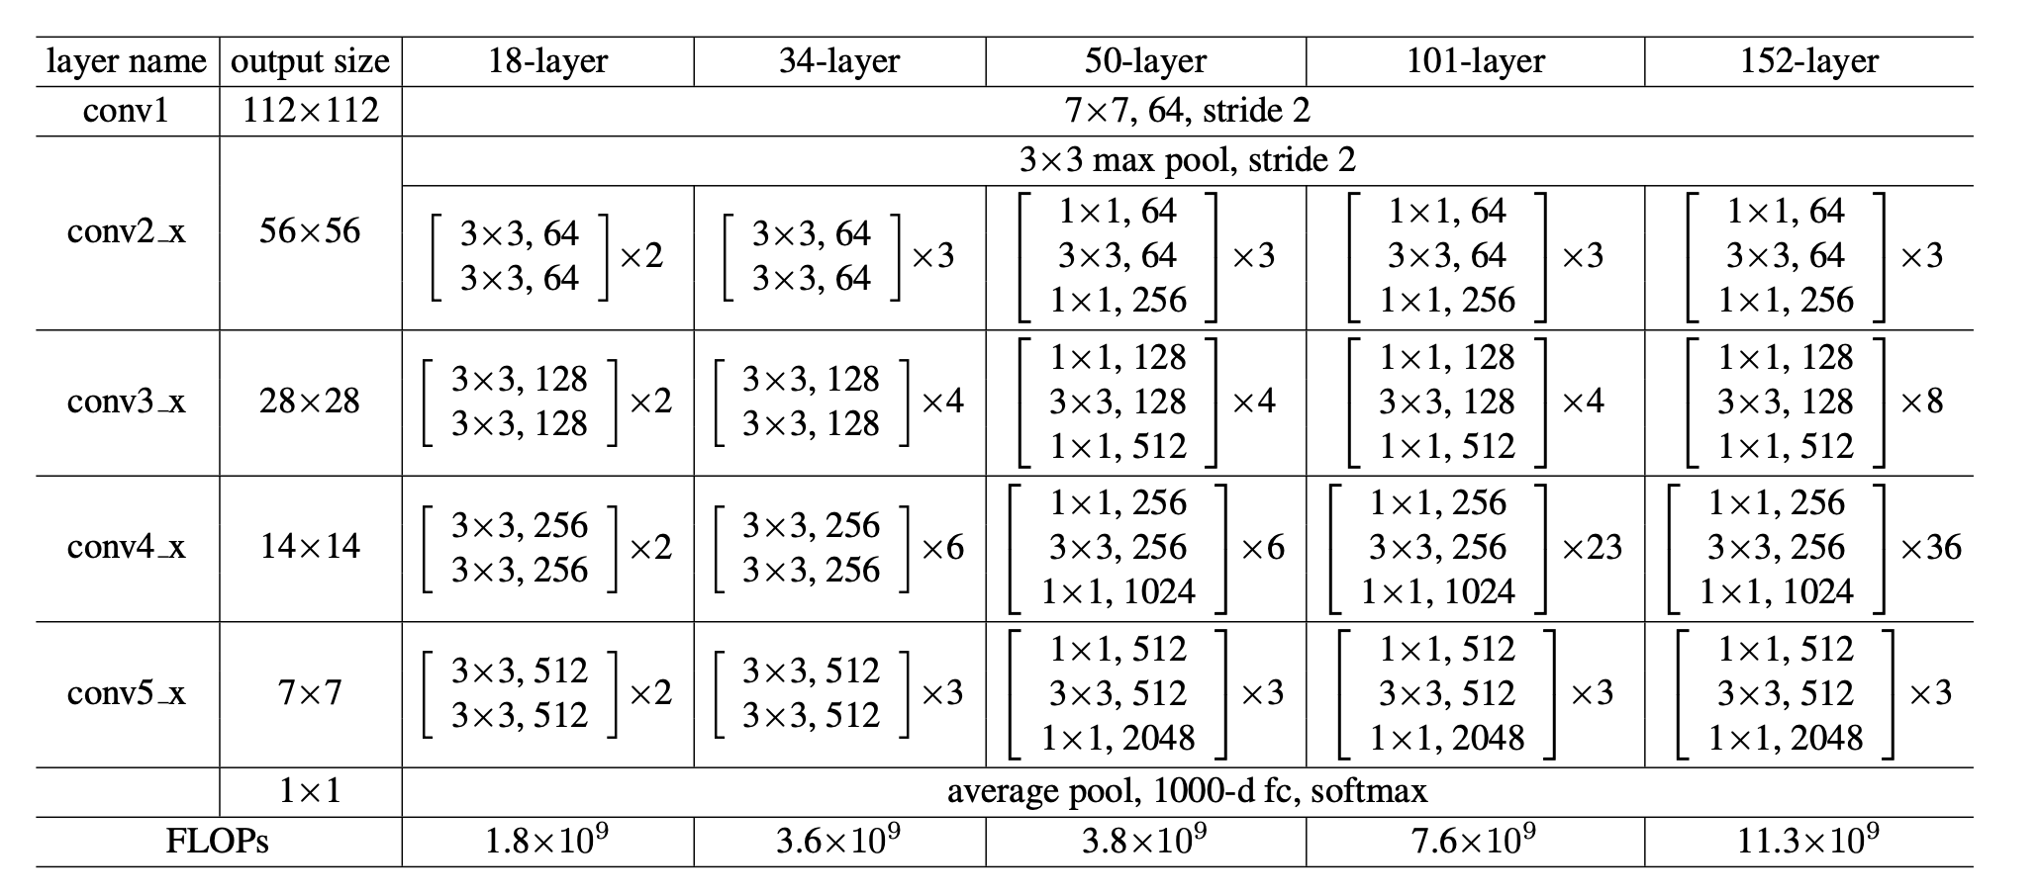
ResNet18-implement
ResNet paper

Slide 43
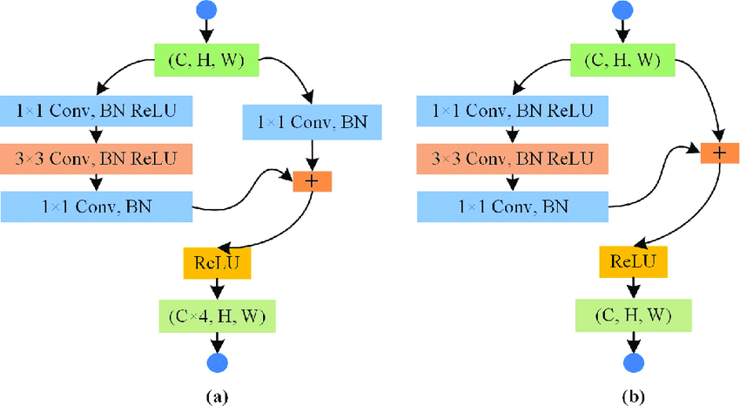
ResNet-18
Conv block v.s identity block
Convolution block
identity block

Slide 44

ResNet18
實線表示維度相同
計算方式為H(x)=F(x)+x
虛線表示維度不同
計算方式為H(x)=F(x)+Wx
其中W是1*1的卷積，調整x的維度
ResNet paper

Slide 45

ResNet18-implement
先完成make_layer，再分別接上4層layer
ResNet paper

Slide 46
Outline
Lab2 task
Layer introduction
ResNet18
CIFAR-10
Sample code introduction

Slide 47

CIFAR-10
CIFAR-10 consists of 32x32 colour images in 10 classes
​50000 training images + 10000 test images

Slide 48
Outline
Lab2 task
Layer introduction
ResNet18
CIFAR-10
Sample code introduction

Slide 49


4. Sample code introduction
記得先上傳resnet18.py

Slide 50


4. Sample code introduction
data augmentation
setting parameter

Slide 51


4. Sample code introduction
Print model summary
from torchsummary import summary
model = SimpleCNN().to(device)
summary(model, (3, 32, 32))
Import thop calculate flops and params
# 創建一個輸入樣本
input = torch.randn(1, 3, 32, 32).to(device)
# 使用 thop 計算 FLOPs 和參數數量
flops, params = profile(model, inputs=(input, ))

Slide 52


4. Sample code introduction
Train model

Slide 53

4. Sample code introduction
Apply to testing data

Slide 54


4. Sample code introduction
Print training process.
Print test accuracy.

Slide 55


4. Sample code introduction
Print and plot result.

Slide 56
Thank you for listening

